Slide 1

Video Resources
Dr. Monica Nagpal

Slide 2
Video Resources
Educational videos as a tool for learning everything
Abstract topics that once seemed difficult to teach and learn are now more accessible and understandable
Video is a powerful medium, but it must be created with an eye for strong pedagogical choices in order to be most effective.
Like, just as video is one tool in the media toolbox, lecture is one strategy on the instructional palette.
The use of videos in teaching and learning serves to not only benefit students, but also teachers, their affiliated institutions

Slide 3

Purpose
Video resources shall be designed for presenting case studies, interviews, digital storytelling, student directed projects, and more. Choosing the appropriate instructional strategy and pairing it with an effective media format is part of the analysis performed during your course design process.

Slide 4

Formats of Audio & Video Programmes
Documentary- This format needs documentation. No fiction, imagination and speculation is allowed in this format but only the facts which are duly authenticated by research and factual elements.
Drama- message is communicated through drama in this format. This format requires creative writing. Facts are presented through an anchor followed by drama.
Docudrama- Here there is no compromise with the fact but mode of presentation is speculative.
Talk- Talk format is the simplest but most popular format of all times. In this format, experts on different topics are invited are asked to deliver a talk. It can also be named as lecture format.
Notes:
Documentary: Feel free to use more than one slide to reflect upon your process. It also helps to add some video of your process. Programs on great personalities, history, geography, Biographies etc are produced in this format.
Drama: It is very effective way of presentation because it avoids the monotony of one voice and offers blend of several voices. Use of mood music enhances it's effect manifold.
Docudrama- For example, you can produce a program which has hard core fact but you use certain characters by using different voices in a radio drama. You may use audio clips of a person but also use voice character by using artist who is a good drama voice and resembles with the voice of the character.
Talk- In this format, Producer gives the content area prior to the talk. This can be recorded and suitably edited before broadcast or can directly be broadcast.

Slide 5
Formats of Audio & Video Programmes
Interview- Experts are invited in this format and an interviewer asks questions from them. Questions can either be framed earlier to interview with consultation of the expert or it can be asked ex tempore.
Feature- Feature is a format where some particular attribute is specifically focused in a program. It covers only one feature or specialty of an aspect.
Magazine- When various kinds of contents are covered altogether.
Vox populi- Vox populi is a french word which means- Voice of the people. It is open forum where people express their opinion. Mostly these programs are recorded outside the studios.
Notes:
Interview- Experts are invited in this format and an interviewer asks questions from them. Questions can either be framed earlier to interview with consultation of the expert or it can be asked ex tempore.
Feature- Feature is a format where some particular attribute is specifically focused in a program. It covers only one feature or specialty of an aspect. Father of nation Mahatma Gandhi was a versatile personality. If a program highlights only one aspect of his personality, it is feature.
Magazine- If you see a printed magazine, you will find many columns cover a wide variety of articles. Similarly, if in a audio/ video program more than one topic is included, it's called a magazine format. This format may cover, news, views, songs, music, thoughts and entertainment segments in one media capsule.
Vox populi- Producers go outside with outdoor recording facilities in public and gather their opinion about a particular topic. They come back in the studio, edit and compile the audio clips for the transmission.

Slide 6

How to Create Videos
[Mobile Video Recording]
[Video Camera Recording]
01
04
02
03
[Screen Recording or Casting]
[Using Images/ Slides]

Slide 7

How to Edit Videos
Open Shot Video Editor
4
Mobile Apps
3
2
Any other
1

Slide 8
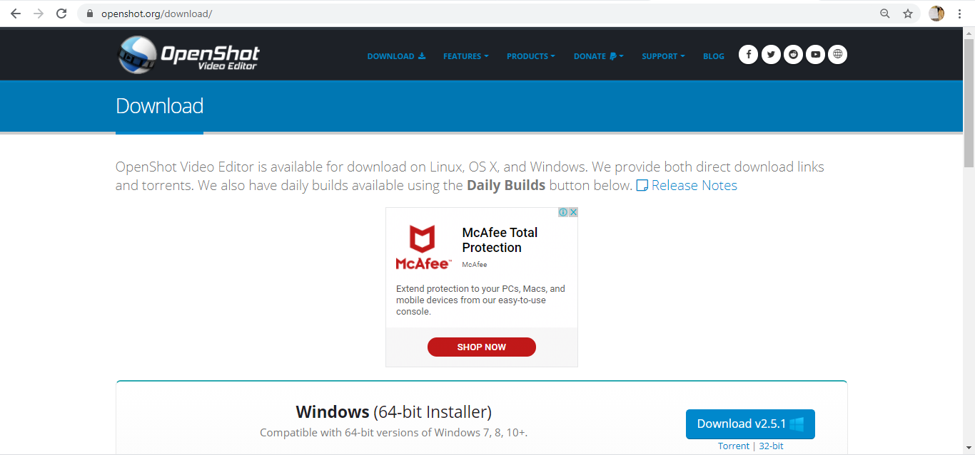
Download OpenShot Video Editor https://www.openshot.org/
Link for downloading
Click here

Slide 9
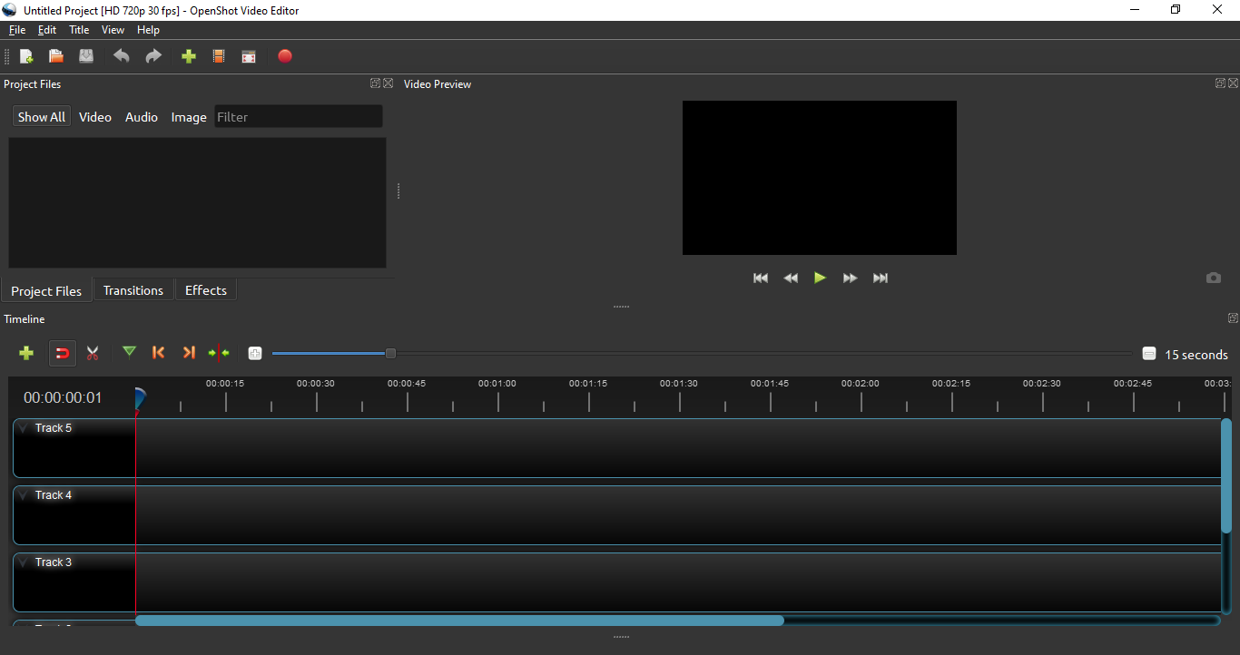
Add Files
Project files, transitions & effects will be seen here
Preview Window
Editing tools
Adding Track

Slide 10
Now Let’s see the Demo of the software...

